Slide 1
HEART ATTACK RISK PREDICTION USING RETINAL IMAGES

Slide 2
ABSTRACT
Cardiovascular disease is one of the most fatal conditions in the present world.
In under a minute, an artificial intelligence program can take a picture of the back of a person's eye and by analyzing the strength of the blood vessels that feed the retina find clues that may point to higher risks of a stroke or heart attack.

Slide 3
ABSTRACT
A unifying goal of work like this is to develop new disease detection or monitoring approaches that are less invasive, more accurate, cheaper and more readily available.
However, one restriction to potential broad population-level applicability of efforts to extract biomarkers from fundus photos is getting the fundus photos themselves, which requires specialized imaging equipment and a trained technician.

Slide 4
INTRODUCTION
Day by day the cases of heart diseases are increasing at a rapid rate and it’s very Important and concerning to predict any such diseases beforehand.
This diagnosis is a difficult task i.e. it should be performed precisely and efficiently
A quite Helpful approach was used to regulate how the model can be used to improve the accuracy of prediction of Heart Attack in any individual.

Slide 5
LITERATURE SURVEY
Method | AUTHOR | Pros | Cons | DATASET | METRICES
There are different algorithm to predict heart disease like naïve Bayes, k Nearest Neighbor (KNN), Decision tree ,Artificial Neural Network(ANN). | Sibgha Taqdees 2021 | Multiple Algorithms used | Less Accuracy | Heart disease Dataset | 85
The strength of the proposed model was quiet satisfying and was able to predict evidence of having a heart disease in a particular individual by using KNN and Logistic Regression which showed a good accuracy | Harshit Jindal 2020 | Extended Accuracy | The training database consist less data | Heart disease Dataset | 65
The current study created and tested several machine-learning-based classification models. The dataset was subjected to Smote to handle unbalanced classes and feature selection technique in order to assess the impact on two distinct performance metrics. | Kelvin Kwakye 2021 | Faster Algorithm | Less features considered | Heart disease Dataset | 93
A heart disease prediction algorithm based on the analysis of the predictive models’ classification performance on combined datasets and the train-test split technique is presented. | Ghulab Nabi Ahmad 2022 | High Resolution dataset used | Slow Operation | Heart disease Dataset | 90
Our proposed method offers an illustrative framework that helps predict heart attacks with high accuracy. | Mohammad Tabrez Quasim 2021 | Web App Supported | Accuracy Low | Heart disease Dataset | 65

Slide 6
LITERATURE SURVEY
Method | AUTHOR | Pros | Cons | DATASET | METRICES
this paper presents a comparative analysis of machine learning techniques like Random Forest (RF), Logistic Regression, Support Vector Machine (SVM), | Rubini PE 2021 | Multiple Evaluation Supported | Not webapp Supported | Heart disease dataset | 75
have also instrumented some machine learning algorithms to calculate the Accuracy (ACC), Sensitivity (SEN), Error Rate, Precision (PRE) and F1 Score (F1) of our model, along with the Negative Predictive Value (NPR), | PRONAB GHOSH 2020 | Extended Accuracy | The training database consist less data | Heart disease dataset | 65
The prediction model is introduced with the several classification techniques and the different combinations of features. | K. S. Ubale 2021 | Faster Algorithm | Less Accuracy | Heart disease dataset | 84
In this paper, a comparative study of various machine learning algorithms is discussed and shows the result. | J.Nageswara Rao 2021 | High Accuracy | Very Complex Algorithm | Heart disease dataset | 90
collected from a tertiary hospital in South India. Seventy percent of the collected data were used to train the prediction system. | Ekta Maini 2021 | Dataset belonging to patient Multiple category | Accuracy Low | Own dataset | 65

Slide 7
EXISTING SYSTEM
Very few systems use the available clinical data for Classification purposes and even if they do ,they are restricted by the large number of association rules that apply.
Diagnosis of the condition solely depends upon the Doctors’s intuition and patient’s records.

Slide 8
Existing Disadvantages
Detection is not possible at an earlier stage.
In the existing system, practical use of various collected data is time consuming .

Slide 9
PROPOSED SYSTEM
We have developed an artificial intelligence (AI) system that can analyze eye scans taken during a routine visit to an optician or eye clinic and identify patients at a high risk of a heart attack.
Changes to the tiny blood vessels in the retina are indicators of broader vascular disease, including problems with the heart.
The training data is trained by using proposed machine learning algorithm RNN classification clustering and Adaboost. algorithm is explained in detail.

Slide 10
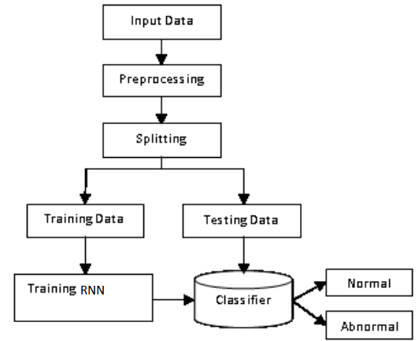
ARCHITECTURE

Slide 11
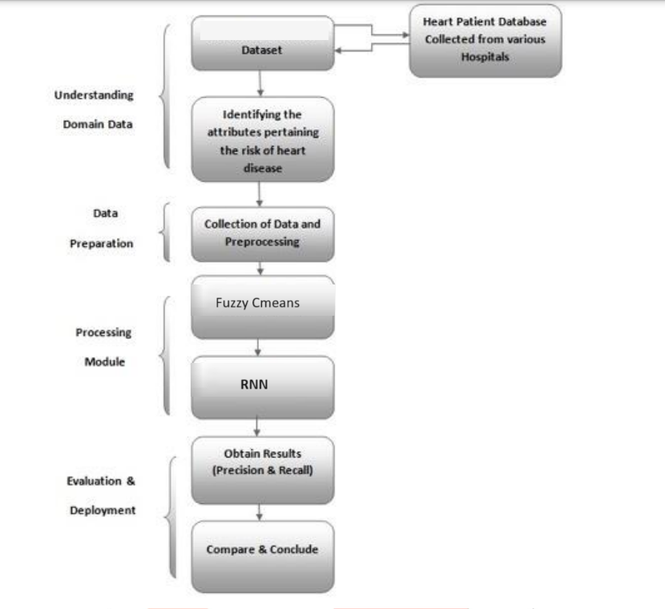
COMPLETE ARCHITECTURE

Slide 12
Advantages:
High performance and accuracy rate.
RNN Classification is very flexible and is widely in various domains with high rates of success.

Slide 13
SYSTEM SPECIFICATION
Software Requirements:
MS Windows XP and above
PYTHON
ANACONDA IDE
Flask
Hardware Requirements:
Hard Disk: Greater than 15GB
RAM: Greater than 1GB
Processor: Core 2 Duo and Above

Slide 14
List Of Modules
Modules for Heart Attack Classification Are
User module
Doctor module
Clustering module

Slide 15
User Module
With the datasets already acquired from the UCI Machine learning repository, We can now proceed with collecting the details of the patients.
Data like the patients name, Blood group, Address, Phone number, sex, weight, Height are collected from the patients themselves to help with the creation of an individual user account.
Already registered user can directly start accessing the system with the help of the user id and password provided.

Slide 16
Doctor Module
Doctor views all patient details and their Medical History.
Doctor with the help of the medical records, punch in the value of the attributes which is fed into FCM for clustering purposes.
The attributes used are given below
age, sex, chest pain, Rest BP, cholesterol, sugar, ECG, Max heart range, Angina, Old peak, Sis lope, vessels, Thalassemia.
The result is a screen that displays the chance of a person contracting heart attack
The system then produces a list of suggestions for the person with the given attributes

Slide 17
Clustering Module
We employ Fuzzy C means Clustering which is apt for clustering medical data.
The data given by the doctor and the patient has been Fed into then algorithm.
It is now the job of the clustering algorithm.
Data clustering is process of dividing data elements into classes or clusters so that items in the same class are as similar as possible, and items in different classes are as dissimilar as possible.

Slide 18
CLASSIFICATION MODULE
This is one of the simplest and fundamental methods of classification where the user does have a little knowledge or no understanding of the dissemination of the data.
The best score achieved of yolo between 1 and the given value is chosen that helps building parallel models on all values of k up to the extreme identified value for which y=9 was selected and scoring is done using the finest models from the available ones.

Slide 19
CONCLUSION
Proposed, is a FCM clustering algorithm for predicting the risk of heart attack in a patient using the attributes collected from the doctor.
Proper adaptation of RNN the data into an optimum number of clusters and aids with detecting the normal and abnormal cases efficiently.

Slide 20
REFERENCES
[1] “The Atlas of Heart Disease and Stroke”, [online]. http://www.who.int/cardiovascular_diseases/res ources/atlas/en/
[2] J. S. Rumsfeld, K. E. Joynt, and T. M. Maddox, “Big data analytics to improve cardiovascular care: promise and challenges”, Nature Reviews Cardiology, Vol.13, No.6, pp.350, 2016.
[3] W. Dai, T. S. Brisimi, W. G. Adams, T. Mela, V. Saligrama, and I. C. Paschalidis, “Classification of hospitalization due to Heart Diseases by supervised learning methods”, International Journal of Medical Informatics, Vol.84, No.3, pp.189–197, 2015.
[4] I. Kamkar, M. Akbarzadeh-T and M. Yaghoobi, "Intelligent water drops a new optimization algorithm for solving the Vehicle Routing Problem", In: Proc. of IEEE International Conference on Systems, Man and Cybernetics, pp.4142-4146, 2010.
[5] N. M. Gazzaz, M. K. Yusoff, M. F. Ramli, H. Juahir, and A. Z. Aris, "Artificial neural network modeling of the water quality index using land use areas as predictors", Water Environment Research, Vol.87, No.2, pp.99- 112, 2015.

